Slide 1

PROJECT 2
Analyze Survey Data
By: Saksham Taneja
Note: Data given is from Survey Respondents and is not from the entire Udacity Student population

Slide 2
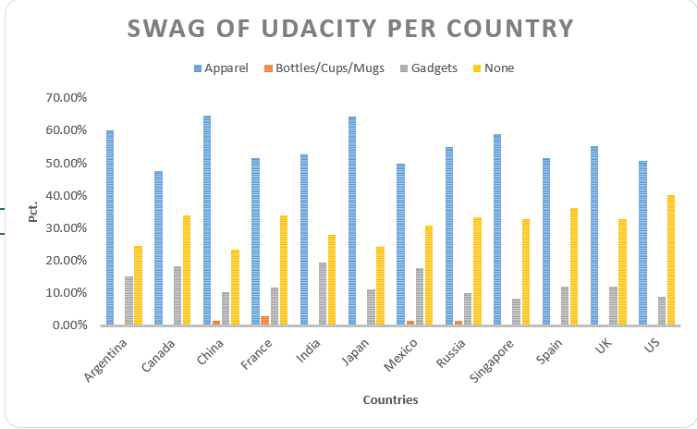
Swag of Udacity per Country
Least swag used is Bottle / cups / mugs
And the most swag is Apparel Then gadgets come into consideration and then bottle mugs Most user want apparel as a swag as they want like it most
Japan and china with highest ratio of apparel as a swag

Slide 3
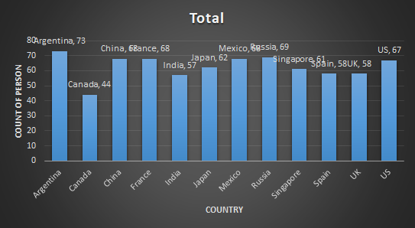
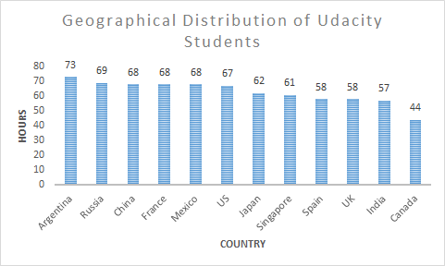
Survey Came from which country
The survey shows that the data that students of udacity came from which country or geographical location
Lowest students is at caneda and highest is at argentina
The graph show users as per country and also on average most of the country have a good user base
In this some country like india which is on 2nd last and China which is on 3rd last

Slide 4
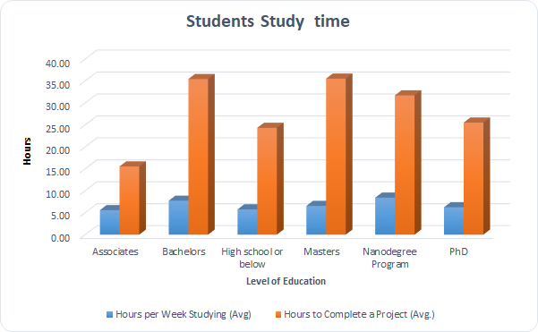
Student Study time and learning hr
The graph shows the data based on students learning per week and total time taken to complete a project
This is shown in Hours
It has various level of education like Bachelors , Master , Nanodegree etc
Highest learning is at Nanodegree program and lowest at associate per week in hours

Slide 5
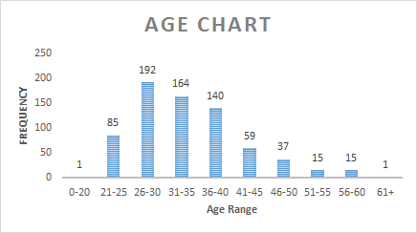

Age Chart of Udacity Students
The metrics Mean (34), Mode (30) and Median (33) used in measures of center and calculated through excel using formulas --- Mean > Median > Mode (starting from left to right) The standard deviation is l around 8.37 which is been calculated through formula =STDEV(range) Which is due to the mean and hence it is 8.3 Range here is in gap of 5 years continuously and total range is between 20-60(approx) The mode is 30 and most frequent accring age here is 26-30(range) which means we have a youth population i.e Data is been mostly populated near mean

